Slide 1
Fall Budget Update

Slide 2
Overall Budget Environment
State budget conversations
Enrollment
Ongoing COVID impact
Planning amid uncertainty

Slide 3
Overall Budget Environment
State budget conversations – Why the Change?
18% - 11% - 5%
Stimulus & Other Funds Pumped into the Economy
Lower Wage Earner Laid Off – Less affect on Income Tax

Slide 4
Overall Budget Environment
State budget conversations – What is next?
Lots of Unknowns
Governor’s Budget
Legislator’s Budget
Federal Stimulus Package
Affect of the Wild Fires
Latest Spike in COVID Infections

Slide 7
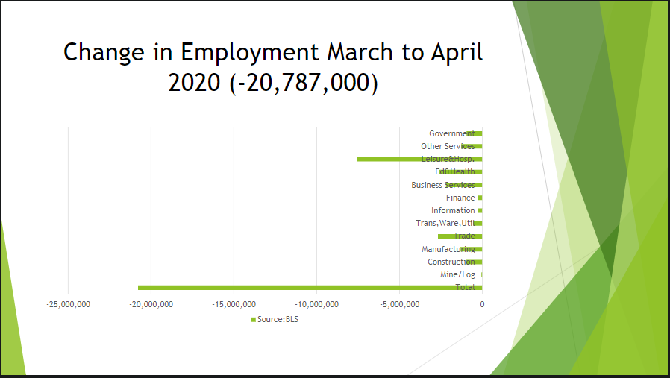

Slide 9
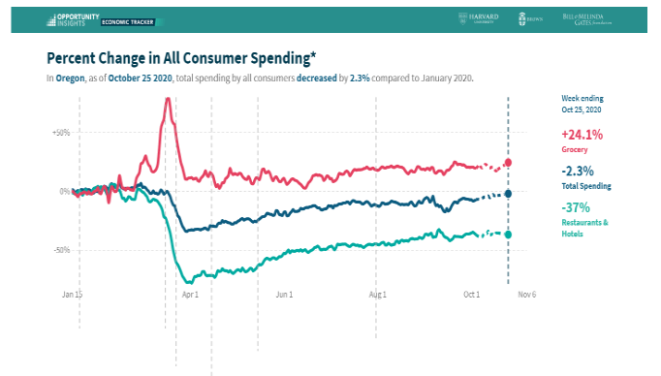

Slide 11
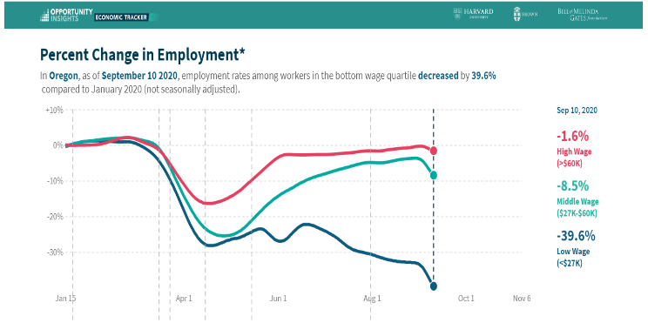

Slide 13
Overall Budget Environment
State budget conversations
Enrollment
Ongoing COVID impact
Planning amid uncertainty

Slide 14
Tuition Revenue Projection
 | 2017-18 | 2018-19 | 2019-20 | 2020-21
Summer | $ 717,561 | $ 1,057,066 | $ 1,020,373 | $ 1,482,865
Fall | $ 6,491,821 | $ 7,086,558 | $ 7,342,959 | $ 7,101,923
Winter | $ 5,884,664 | $ 6,219,449 | $ 6,200,660 | $ 6,222,587
Spring | $ 5,508,954 | $ 5,716,332 | $ 5,534,947 | $ 5,702,891
Total Tuition | $ 18,603,000 | $ 20,079,405 | $ 20,098,938 | $ 20,510,265
Change vs. Fall | 2017-18 | 2018-19 | 2019-20 | Average
Winter | -9.4% | -12.2% | -15.6% | -12.4%
Spring | -15.1% | -19.3% | -24.6% | -19.7%
All Tuition & Fees Projection |  |  |  | $ 20,490,865

Slide 15
Financial Impact
Changes In: | From | To | Resulting Change
Tuition Revenue | (4.45%) | (6.64%) | $ (530,120)
PERS | 29.7% | 8.4% | $ 801,545
State Aid | (17%) | (5%) | $2,814,714
 |  |  | $3,086,139

Slide 16
Variables | 2020-21 | 2021-22
REVENUE
IS Tuition | 8.00% | 8.00%
Int'l Tuition | 8.00% | 8.00%
Enrollment | -6.64% | 2.00%
State Aid | -0.95% | -5.00%
Property Tax | 4.50% | 4.50%
EXPENSES
PT Faculty | 2.30% | 2.50%
Faculty | 2.30% | 2.50%
Management | 2.30% | 2.50%
Classified | 2.30% | 2.50%
PERS | 0.00% | 8.40%
Health Insur | 3.00% | 3.00%
M&S | 0.00% | 2.00%

Slide 17
 | 2019-21 Biennium |  | 2021-23 Biennium |  | 2023-25 Biennium
 | 2019-20 | 2020-21 | 2021-22 | 2022-23 | 2023-24 | 2024-25
State Aid | 23,455,946 | 23,231,960 | 22,283,149 | 22,283,149 | 23,397,306 | 23,397,306
Property Tax | 8,936,049 | 9,338,171 | 9,758,389 | 10,197,516 | 10,656,405 | 11,135,943
Tuition | 20,322,718 | 20,490,868 | 22,542,776 | 24,341,488 | 25,788,419 | 27,190,645
Other Revenue | 912,582 | 858,899 | 886,832 | 965,225 | 1,101,450 | 1,224,286
Revenue | $ 53,627,295 | $ 53,919,898 | $ 55,471,146 | $ 57,787,378 | $ 60,943,579 | $ 62,948,180
Personnel Costs | 46,754,654 | 47,890,393 | 47,728,746 | 47,537,151 | 50,337,975 | 51,848,147
Materials/Services | 5,765,007 | 5,765,007 | 5,880,307 | 5,997,913 | 6,117,872 | 6,240,229
Performance Packages | - | 296,807 | 46,124 | 284,280 | 238,000 | 260,000
Capital Proj Oper Costs | - | - | 294,727 | - | - | -
Strategic Investments | - | 200,000 | 200,000 | 400,000 | 400,000 | 500,000
Operational Efficiencies | - | (2,014,233) | (1,750,000) | (500,000) | - | -
Transfers Out | 1,626,316 | 1,667,068 | 1,958,368 | 1,958,368 | 2,208,368 | 2,208,368
Expenses | $ 54,145,977 | $ 53,805,042 | $ 54,358,273 | $ 55,677,712 | $ 59,302,214 | $ 61,056,744
Annual Budget Balance | $ (518,682) | $ 114,856 | $ 1,112,873 | $ 2,109,666 | $ 1,641,365 | $ 1,891,436

Slide 18
 | 2019-21 Biennium |  | 2021-23 Biennium |  | 2023-25 Biennium
 | 2019-20 | 2020-21 | 2021-22 | 2022-23 | 2023-24 | 2024-25
State Aid | 23,455,946 | 23,231,960 | 22,283,149 | 22,283,149 | 23,397,306 | 23,397,306
Property Tax | 8,936,049 | 9,338,171 | 9,758,389 | 10,197,516 | 10,656,405 | 11,135,943
Tuition | 20,322,718 | 20,490,868 | 22,542,776 | 24,341,488 | 25,788,419 | 27,190,645
Other Revenue | 912,582 | 858,899 | 886,832 | 965,225 | 1,101,450 | 1,224,286
Revenue | $ 53,627,295 | $ 53,919,898 | $ 55,471,146 | $ 57,787,378 | $ 60,943,579 | $ 62,948,180
Personnel Costs | 46,754,654 | 47,890,393 | 47,728,746 | 47,537,151 | 50,337,975 | 51,848,147
Materials/Services | 5,765,007 | 5,765,007 | 5,880,307 | 5,997,913 | 6,117,872 | 6,240,229
Performance Packages | - | 296,807 | 46,124 | 284,280 | 238,000 | 260,000
Capital Proj Oper Costs | - | - | 294,727 | - | - | -
Strategic Investments | - | 200,000 | 200,000 | 400,000 | 400,000 | 500,000
Operational Efficiencies | - | (2,014,233) | (1,750,000) | (500,000) | - | -
Transfers Out | 1,626,316 | 1,667,068 | 1,958,368 | 1,958,368 | 2,208,368 | 2,208,368
Expenses | $ 54,145,977 | $ 53,805,042 | $ 54,358,273 | $ 55,677,712 | $ 59,302,214 | $ 61,056,744
Annual Budget Balance | $ (518,682) | $ 114,856 | $ 1,112,873 | $ 2,109,666 | $ 1,641,365 | $ 1,891,436

Slide 20
Budget Planning
Entering 2021-22 budget discussion with assumed cost reductions
Budget next steps
December Budget Team
Accepting budget requests
Discussion of reduction options
January Board meeting
March tuition decision

